Slide 1
COS70006
OOP
Creating objects in code and more
Notes:
SDJ Lecture 3 : Java & BlueJ
© Swinburne or © Pearson Education, IncA Bayley
A Bayley

Slide 2
This lecture…
Creating objects in code
Reference types vs primitive types
Class String
Creating objects in main()
Console I/O
Import
More about static

Slide 3

We are going to use the following in our programs
Objects based on a class
  Usually these classes have no static methods
Classes with static methods
  A class that starts our program running with a public static void main method
  Other static methods and variables are possible

Slide 4
Creating objects in code
To create an object using code
  Declare a variable of the correct type
  Construct it (new + call the constructor)
To call methods, prefix the variable:
TicketMachine machine;
Student student1;
Cat myCat;
  machine = new TicketMachine(2000);
  student1 = new Student("Albert Einsteen", "L00415");
  myCat = new Cat();
machine.printTicket();
student1.changeName("Albert Einstein");

Slide 5
Primitive types vs. object types
Stack Memory
Heap Memory
Student student1;
object type
Reference to an object
primitive type
int i;
32
Actual value
Notes:
SDJ Lecture 6 : Object Collaboration
© Swinburne, © Pearson Education, Inc
Stack Memory:
Maintains local variables. They contain method specific values that are short-lived and references to other objects in the heap that are getting referred from the method. Stack memory is always referenced in LIFO (Last-In-First-Out) order. Whenever a method is invoked, a new block is created in the stack memory for the method to hold local primitive values and reference to other objects in the method. As soon as method ends, the block becomes unused and become available for next method.
Stack memory size is very less compared to Heap memory.
Heap Memory:
Whenever we create any object, it’s always created in the Heap space. Garbage Collection runs on the heap memory to free the memory used by objects that doesn’t have any reference. Any object created in the heap space has global access and can be referenced from anywhere of the application.

Slide 6
Object Reference
Student student1;
student1 = new Student("Fred Nurq", "190107");
null
student1 : Student
A reference to a
Student object

Slide 7
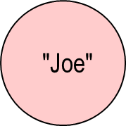
String Class
Strings are objects of the String class
String str = “Joe”;
str
Stack Memory
Heap Memory

Slide 8
String Objects
variables of type String:
  contain zero or more character values in sequence
  the first character has an index of 0
Strings are immutable objects
  "immutable" -- their values cannot be changed after they are created”
String s = " Hello world!";
H
e
l
l
o
w
o
r
l
d
!
0
1
2
3
4
5
6
7
8
9
10
11
12
string of length 13
X
illegal, not an array, immutable
s[2] = 'c';
Notes:
SDJ Lecture 3 : Java & BlueJ
© Swinburne or © Pearson Education, IncA Bayley

Slide 9
String Objects: some useful methods
H
e
l
l
o
w
o
r
l
d
!
s
0
1
2
3
4
5
6
7
8
9
10
11
12
Method | Description | Example
s.length(); | returns length of string | 13
s.charAt(7); | returns character at specified index | 'w'
s.indexOf('l'); | returns index of first occurrence of character specified | 3
s.lastIndexOf('l'); | returns index of last occurrence of character specified | 10
s.toUpperCase(); | returns string converted to upper case | " HELLO WORLD!"
s.toLowerCase(); | returns string converted to lower case | " hello world!"
s.substring(7); | returns string starting at specified location | "world!"
s.substring(7, 10); | returns string starting at specified location, up to the second location | "wor"

Slide 10
String Objects
String str = "aBx";
:String
aBx
str
Stack Memory
Heap Memory
char c = str.charAt(1);
Effectively c = 'b'
returns a different object (unless already lowercase)
str = str.toLowerCase();
:String
abx
:String
a B x
str
now garbage
ie inaccessible
Stack Memory
Heap Memory
Notes:
//
SDJ Lecture 3 : Java & BlueJ
© Swinburne or © Pearson Education, IncA Bayley

Slide 11
String Objects
Student s = new Student();
String login = s.getLoginName();
public class Student
{
String name = “Fred Nurq”;
String id = “190107”;
………
public String getLoginName()
{
return name.substring(0,4) + id.substring(0,3);
}
}
(Source: BlueJ Book, p53)
:String
Fred Nurq
:String
Fred
name
:String
190107
:String
190
now garbage
ie inaccessible
id
:String
Fred190
Final result
login
Notes:
SDJ Lecture 3 : Java & BlueJ
© Swinburne or © Pearson Education, IncA Bayley

Slide 12
More about String class…
To find out more about String look at the API
  over 60 methods
  http://java.sun.com/javase/6/docs/api/java/lang/String.html
Do a java tutorial
  http://java.sun.com/docs/books/tutorial/java/data/strings.html

Slide 13
Calling methods
A method of the same class: no dot needed
A static method of another class: <ClassName>.<method>
An ordinary method belongs to an object :<objectRef>.<method>
  printStars();
  answer = calculateTrend( rawData, 2010, 0.01 );
double length = Math.sqrt(x);
  System.out.println();
  myFriend.like();
  if (sentence.length() > 0) …
  String[] words = sentence.split("[ ,.]+");

Slide 14
We are going to use the following in our programs
Objects based on a class
  Usually these classes have no static methods
Classes with static methods
  A class that starts our program running with a public static void main method
  Other static methods and variables are possible

Slide 15
TicketMachine
Train stations often provide ticket machines that print a ticket when a customer inserts the correct money for their fare. Imagine we have defined a class that models something like these ticket machines (Source: BlueJ Book)
Constructs the object (price $550)
public class TicketDemo
{
  public static void main (String[ ] args)
  {
  TicketMachine machine = new TicketMachine(550);
  System.out.println("stored price=" + machine.getPrice());
  machine.insertMoney(500);
  machine.insertMoney(100);
  machine.printTicket();
  System.out.println("balance=" +
  machine.getBalance());
  int change = machine.refundBalance();
  System.out.println("change=" + change);
  System.out.println("balance=" + machine.getBalance());
  }
}
retrieves price
combines with "stored price="
display
Notes:
(Source: BlueJBook, p19)
SDJ Lecture 3 : Java & BlueJ
© Swinburne or © Pearson Education, IncA Bayley

Slide 16
String class static method: String.format()
Class String has;
public static String format(String fmt, … )
  Returns a formatted string using the specified format and arguments
Type of the object that will be formatted in the output
s- String, d-integers, f-floating point numbers
String name = “Sam”;
String s = String.format(“Name is %s", name);
Name is Sam
String name = “Sam”;
String s = String.format("%6s!!!", name);
String s = String.format("%-6s!!!", name);
Sam!!!
Sam !!!
double x = 0.09999978;
String s = String.format("x = %5.2f", x);
x = 0.10
Maximum number of output characters for this object
Number of decimal digits you wish to print on the output
Notes:
%s : will format the string as it is.
%6s : will format the string as it is. If the string has less than 6 characters, the output will be padded on the left.
%-6s : will format the string as it is. If the string has less than 6 characters, the output will be padded on the left.
%f : will format the number as it is.
%6f : will format the number as it is. If the number has less than 6 digits, the output will be padded on the left.
%.6f : will format maximum 6 decimal digits of the number.
%5.2f : will format maximum 5 decimal digits of the number. If the number of digits is not enough, it will be padded.
SDJ Lecture 3 : Java & BlueJ
© Swinburne or © Pearson Education, IncA Bayley

Slide 17
Packages
Package = directory.
Java classes can be grouped together in packages.
A package name is the same as the directory (folder) name which contains the .java files.
Package declaration
  The first statement, other than comments, in a Java source file, must be the package declaration.
package illustrator;
public class Circle
{
//class body
}

Slide 18
Imports
Allow you to specify classes from other packages that can be referenced without qualifying them with their package.
The packages that you need to use from other libraries is given in an import statement.
2 ways to import:
“*” means all classes in the package (lazy!)
package illustrator;
import java.util.*;
import java.util.Scanner;
Better

Slide 19
Interactive Programs
Programs that interact with users through statements performing input and output
A Scanner enables a program to read data for use in a program
The input can come from the user at the keyboard or a file on the disk
Before using a scanner you must create and specify the source
import java.util.Scanner;
public class Test
{
//class body
}

Slide 20
Interactive Programs
Scanner input = new Scanner(System.in);
Creates a new scanner object that reads characters typed by the user at the keyboard
Enables the program to read information typed by user
(System is in java.lang.System)
int number = input.nextInt();
double dNum = input.nextDouble();
String txt= input.nextLine();
Obtains an int value as input from the user
Obtains a double value as input from the user
Obtains a String value as input from the user

Slide 21
TicketMachine with Console input
import java.util.Scanner;
public class TicketDemo2
{
  public static void main (String[] args)
  {
  Scanner reader = new Scanner(System.in);
  TicketMachine machine = new TicketMachine(550);
  System.out.println("stored price=" + machine.getPrice());
  System.out.println("enter first amount: ");
  int amt = reader.nextInt();
  machine.insertMoney(amt);
  System.out.println("enter 2nd amount: ");
  amt = reader.nextInt();
  machine.insertMoney(amt);
  machine.printTicket();
  …
Don't declare amt again
nextInt() ignores leading whitespace
Notes:
SDJ Lecture 3 : Java & BlueJ
© Swinburne or © Pearson Education, IncA Bayley

Slide 22
Read more about Scanner class…
  BlueJ text 12.9.5
  API doc (select package java.util)
  http://www.cs.utexas.edu/users/ndale/Scanner.html
  http://www.java-tips.org/java-se-tips/java.util/scanning-text-with-java.util.scanner-3.html
  http://www.cs.utk.edu/~cs365/examples/datacheck.html
The Scanner class is very useful!
Notes:
SDJ Lecture 3 : Java & BlueJ
© Swinburne or © Pearson Education, IncA Bayley

Slide 23
We are going to use the following in our programs
Objects based on a class
  Usually these classes have no static methods
Classes with static methods
  A class that starts our program running with a public static void main method
  Other static methods and variables are possible

Slide 24
Hello with more static methods
public class Hello4
{
  public static void main (String[ ] args)
  {
  printStars();
  System.out.println("Hello students");
  printStars();
  }
  private static void printStars()
  {
  System.out.println("**************");
  }
}
(Same class) method call.
Another method.
**************
Hello Students
**************

Slide 25
Hello with more static methods
Run:
java Hello5 Fred
public class Hello5
{
  private String allStars = "*****************************************";
  public static void main (String[] args)
  {
  String s = "Hello " + args[0];
  printStars(s.length());
  System.out.println(s);
  printStars(s.length());
  }
  private static void printStars(int n)
  {
  System.out.println(allStars.subString(0,n));
  }
}
.length() gives number of chars
Expected Output:
**********
Hello Fred
**********
Compile error here

Slide 26
..corrected
public class Hello5
{
  private static String allStars = "*********************";
  public static void main (String[ ] args)
  {
  …. as before
  }
}
or, better style:
public class Hello5
{
  private static final String ALL_STARS = "*********************";
  …. as before
  private static void printStars(int n)
  {
  System.out.println(ALL_STARS.subString(0,n));
  }
}

Slide 27
Static rule
A static method cannot refer to a non-static member (an instance variable or non-static method or non-static constant).
  Unless they are passed as parameters.
Reason:
  Static members (or "class" members) belong to the class; they are available even if no instances have been created.
  Instance members require an object to have been created (using the class as a blueprint), eg the data needs an object to store it in.
  Note: ordinary (instance) methods can refer to static members.

Slide 28
Scope – review
What does scope mean?
  The places in a program that can “see” (access) a variable, method or class.
Why do we care about it?
  Poor scope (ie too wide) means our programs
    may become corrupted or vulnerable
    May not run as expected
How do we control scope?
  Use an access modifier public, private
  By being careful about
    where we declare variables and methods
    how we declare variables and methods
This is a more general definition than in some textbooks.

Slide 29
Reading
BlueJ Chapter 2, pages 49-61

Slide 30
COS70006
OOP
Object Collaboration
Based on Barnes and Kolling Chapter 3
Notes:
SDJ Lecture 6 : Object Collaboration
© Swinburne, © Pearson Education, Inc

Slide 31
Learning Objectives
Students should be
  able to use instance variables to create references from one object to other objects
  able to explain & show how one object uses another object
  beginning to understand the benefits of using many objects rather than one big object
  able to use the design notations that represents one object working with another object

Slide 32

So Far
To design a student class then we might choose variables like
  int to represent their age
  double to represent their fees
  String to represent their name
  int to represent their ID
We would say the Student has attributes of age, fees and name
But, the student could have other knowledge …
:Student
age
fees
name
id

Slide 33
Collaborating classes
… other knowledge involving other objects
For example, all students may have a cat…
A student object can (potentially) access a cat object
In this case we would declare an instance variable of type Cat in the student class
  private Cat myCat;
So AFTER we have given a value to this instance variable:
:Student
myCat
:Cat

Slide 34
Collaborating classes: Association
We say there is an association between the two classes
If Student calls methods in Cat then we say
Cat is a collaborator of Student
  “Cat helps Student”
  or “Cat provides services for Student”
  or “Cat is a server for Student”
Student
Cat

Slide 35


Association Relationship
class A
{
private B b;
……
……
……
}
Directed Association
Bidirectional Association
class A
{
private B myB;
……
……
……
}
class B
{
private A myA;
……
……
……
}

Slide 36
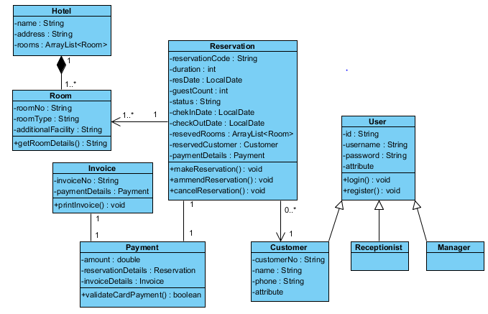
Sample class diagram: Hotel Reservation System
OO systems are made up of objects working with other objects
The hard part is working out what classes we should have in our solutions

Slide 37
null
null is a special value in Java
All object variables are initialised to null.
You can assign and test for null:
private Cat myCat;
if(myCat == null) { ... }
myCat = null;
Note the distinction between equality operator
&
:Student
myCat
assignment
null
Notes:
SDJ Lecture 6 : Object Collaboration
© Swinburne, © Pearson Education, Inc

Slide 38
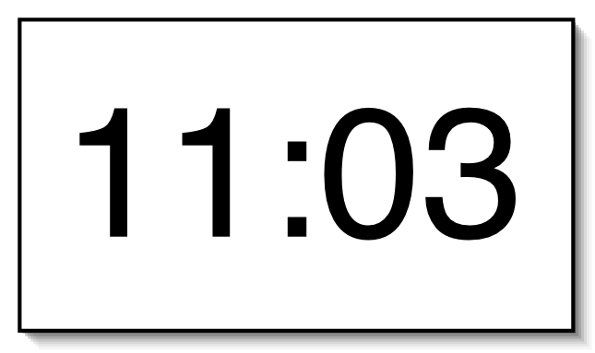
A digital clock display
Abstraction of a real-world clock
What does a clock do?
Where do I start?
Put this all in one object ?
Can the problem be broken down into smaller parts?
Focus on the information required rather than how it is displayed
Notes:
SDJ Lecture 6 : Object Collaboration
© Swinburne, © Pearson Education, Inc
(Source: BlueJ Book, p62)
If you implement the whole clock display in one class -> complexity is high
To overcome this complexity can we try to break the problem into subcomponents?

Slide 39



Abstracting and Modularizing the clock display
One four-digit display?
Or two two-digit displays?
Are there any other devices that might need a two digit display?
Notes:
SDJ Lecture 6 : Object Collaboration
© Swinburne, © Pearson Education, Inc
One way to look at it is to consider it as consisting of a single display with four digits (two digits for the hours, two for the minutes).
Abstraction and Modularization
Modularization is the process of dividing large things (problems) into smaller parts, while abstraction is the ability to ignore details to focus on the bigger picture.
We divide the problem into sub-problems, then again into sub-sub-problems, and so on, until the individual problems are small enough to be easy to deal with.
These are called modules. Once we solve one of the sub-problems, we do not think about the details of that part any more, but treat the solution as a single building block for our next problem.
If we now abstract away from that very low-level view, we can see that it could also be viewed as two separate two-digit displays (one pair for the hours and one pair for the minutes). One pair starts at 0, increases by 1 each hour, and rolls back to 0 after reaching its limit of 23. The other rolls back to 0 after reaching its limit of 59.
we might think of them as being objects that can display values from zero up to a given limit. The value can be incremented, but, if the value reaches the limit, it rolls over to zero. That is the level of abstraction you need to achieve.

Slide 40
Implementation - NumberDisplay
We have started the design – what does the display need to know?
public class NumberDisplay
{
private int limit;
private int value;
Constructor and
methods omitted.
}
Different displays may have different limits, 12 hour, 24 hour, 60 minutes, 100 centiseconds
Its current number to display
Notes:
SDJ Lecture 6 : Object Collaboration
© Swinburne, © Pearson Education, Inc

Slide 41
Implementation - ClockDisplay
The Digital Clock will have two number displays – the object will have references to two distinct number display objects
public class ClockDisplay
{
private NumberDisplay hours;
private NumberDisplay minutes;
Constructor and
methods omitted.
}
Notes:
SDJ Lecture 6 : Object Collaboration
© Swinburne, © Pearson Education, Inc
When you think a bit more about the complete clock display, you need to build a complete clock display by having an object that has, internally, two number
displays (one for the hours and one for the minutes).

Slide 42
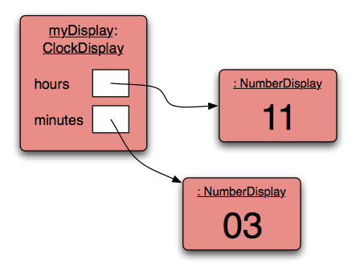
Object diagram
3 objects
Object type is its class
Two references to objects
Memory addresses
of objects
Notes:
SDJ Lecture 6 : Object Collaboration
© Swinburne, © Pearson Education, Inc

Slide 43
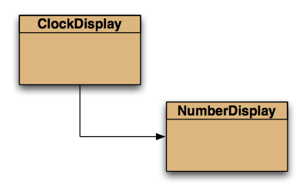
Class diagram (simplest version)
ClockDisplay objects
will work with (use)
NumberDisplay objects
2
A better class diagram has “2” to indicate how many number display objects
Notes:
SDJ Lecture 6 : Object Collaboration
© Swinburne, © Pearson Education, Inc
In fact BlueJ shows dependencies between classes, as dashed lines.

Slide 44
Source code: NumberDisplay
what state should the object be in when it is created?
public class NumberDisplay
{
  ………
  ………
    public NumberDisplay(int rollOverLimit)
    {
    limit = rollOverLimit;
    value = 0;
    }
    public void increment()
    {
    value = (value + 1) % limit;
    }
}
This display increments the value by one. It rolls over to zero when the limit is reached.
Try different values to see how this works
Notes:
SDJ Lecture 6 : Object Collaboration
© Swinburne, © Pearson Education, Inc
The constructor receives the roll-over limit as a parameter.
If, for example, 24 is passed in as the roll-over limit, the display will roll over to 0 at that value. Thus, the range for the display value would be 0 to 23.
This feature allows us to use this class for both hour and minute displays.
For the hour display, we will create a NumberDisplay object with limit 24;
For the minute display, we will create NumberDisplay object with limit 60.

Slide 45
The remainder operator
The 'division' operator (/), when applied to int operands, returns the result of an integer division.
The ‘remainder' operator (%) returns the remainder of an integer division.
17 / 5 → result 3, remainder 2
In Java:
17 / 5 == 3
17 % 5 == 2
% also works with negatives
-17 / 5 → -3
-17 % 5 → -2
Java also has % for double 17.4 % 5.0 → 2.4
% is often called ‘modulus’ operator
Limit = 60 (minutes)
59 % 60 =
60 % 60 =
61 % 60 =
Limit = 60 (minutes)
59 % 60 = 59
60 % 60 = 0
61 % 60 = 1
We don’t use this often
Notes:
What is -1 % 60 ? -61 % 60 ? -61 / 60 ? (not relevant to NumberDisplay)
SDJ Lecture 6 : Object Collaboration
© Swinburne, © Pearson Education, Inc

Slide 46
Source code: NumberDisplay
public class NumberDisplay
{
  ………
  ………
    public String getDisplayValue()
    {
    if(value < 10) {
    return "0" + value;
    }
    else {
    return "" + value;
    }
    }
}
Returns a string and we want the leading “0” in the display.
Notes:
SDJ Lecture 6 : Object Collaboration
© Swinburne, © Pearson Education, Inc
Since we need a two digit string we append 0 to the front if the value is less than 10.

Slide 47
Objects creating objects
public class ClockDisplay
{
private NumberDisplay hours;
private NumberDisplay minutes;
private String displayString;
public ClockDisplay()
{
hours = new NumberDisplay(24);
minutes = new NumberDisplay(60);
updateDisplay();
}
}
When we create the clock display we also create the number displays
Notes:
SDJ Lecture 6 : Object Collaboration
© Swinburne, © Pearson Education, Inc

Slide 48
Objects creating objects
in class NumberDisplay:
public NumberDisplay(int rollOverLimit)
formal parameter
Create a new object by using new
in class ClockDisplay:
hours = new NumberDisplay(24);
actual parameter
(argument)
Assign object to variable
Notes:
SDJ Lecture 6 : Object Collaboration
© Swinburne, © Pearson Education, Inc

Slide 49
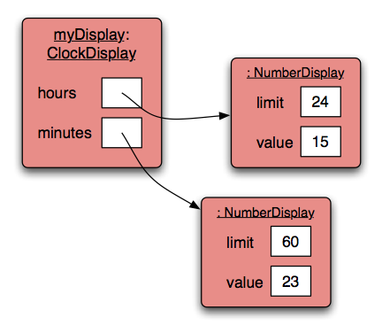
ClockDisplay object diagram
Notes:
SDJ Lecture 6 : Object Collaboration
© Swinburne, © Pearson Education, Inc

Slide 50
Objects creating objects: multiple constructors
public class ClockDisplay
{
private NumberDisplay hours;
private NumberDisplay minutes;
private String displayString;
public ClockDisplay()
{
hours = new NumberDisplay(24);
minutes = new NumberDisplay(60);
updateDisplay();
}
public ClockDisplay(int hour, int minute)
{
hours = new NumberDisplay(24);
minutes = new NumberDisplay(60);
setTime(hour, minute);
}
}
Two very similar constructors
Notes:
SDJ Lecture 6 : Object Collaboration
© Swinburne, © Pearson Education, Inc

Slide 51
Internal method: updateDisplay()
public class ClockDisplay
{
………
………
………
  /**
  * Update the internal string that
  * represents the display.
  */
  private void updateDisplay()
  {
  displayString =
  hours.getDisplayValue() + ":" +
  minutes.getDisplayValue();
  }
}
Notes:
SDJ Lecture 6 : Object Collaboration
© Swinburne, © Pearson Education, Inc

Slide 52
Method calling
public class ClockDisplay
{
………
………
………
  public void timeTick()
  {
  minutes.increment();
  if(minutes.getValue() == 0)
  {
  // it just rolled over!
  hours.increment();
  }
  updateDisplay();
  }
}
What does it do?
Notes:
SDJ Lecture 6 : Object Collaboration
© Swinburne, © Pearson Education, Inc
This method should get called once every minute - it makes the clock display go one minute forward.
If the minutes object has got rolled back to 0 then we need to increment hours.

Slide 53
How did we call methods???
Within the same object
internal method calls
updateDisplay();
...
private void updateDisplay()
external method calls
minutes.increment();
From one object to another object
Notes:
SDJ Lecture 6 : Object Collaboration
© Swinburne, © Pearson Education, Inc

Slide 54
Objects creating objects: using this()
public class ClockDisplay
{
private NumberDisplay hours;
private NumberDisplay minutes;
private String displayString;
public ClockDisplay()
{
hours = new NumberDisplay(24);
minutes = new NumberDisplay(60);
updateDisplay();
}
public ClockDisplay(int hour, int minute)
{
this();
setTime(hour, minute);
}
}
this() denotes another constructor of the same class
Notes:
SDJ Lecture 6 : Object Collaboration
© Swinburne, © Pearson Education, Inc

Slide 55
this as an object reference
this (without parentheses) means “the current object”
public class Student
{
private int id;
private String studName;
public Student(int id, String name)
{
this.id = id;
studName = name;
}
public void enrol(University uni)
{
uni.addStudent(this);
}
……
……
}
this required
This keyword not required – no ambiguity
Current student object is added to the university object

Slide 56
Design Review
Abstraction
  Client code (outside world) only interacts with ClockDisplay,
  doesn’t need to know about the internal structure,
  only calls timeTick(), getTime(), setTime()
Modularity: re-usability
  NumberDisplay is reusable
  ClockDisplay does not do input/output – responsibility of client
    so can be used in a GUI or console application
Notes:
SDJ Lecture 6 : Object Collaboration
© Swinburne, © Pearson Education, Inc

Slide 57
Reading & Exercises
Barnes & Kolling Pages 62-81 (Chapter 3 to Section 3.11)
Exercises
  3.1 to 3.30
  Change TimeDisplay to hh:mm:ss
  Change to hh:mm where hh is 1 to 12
  Change to distributed calls of increment
Notes:
SDJ Lecture 6 : Object Collaboration
© Swinburne, © Pearson Education, Inc

